Slide 1

USE OF AI IN MS WORD

Slide 2

Generative AI in Word refers to Microsoft 365 Copilot or, more specifically, Copilot in Word. It uses AI to help people write, edit, and understand documents more easily by drafting content, adjusting formatting, improving flow, and summarizing information.

Slide 3
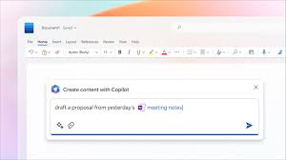
HOW TO GET STARTED
To get started using AI in Word, follow these steps:
From the Home tab, select Copilot. (If you don’t see Copilot, you’ll need to add it to your Microsoft 365 subscription.)
Type instructions for what you’d like Copilot to help you with or select a suggested prompt.
Select Send (the paper airplane icon) or press Enter on your keyboard.

Slide 4

BENEFITS OF AI IN WORD
Instead of just checking for spelling and grammar mistakes, Word’s AI can help improve the quality of your writing.
Writing a first draft can be tough, especially if you’re not sure where to start. With AI, you can tell Word what you want to write about, and it will create a draft for you. Then, you can focus on making the content exactly the way you want it, saving you from writer's block.

Slide 5

When you’re stuck with no ideas, staring at a blank screen can be stressful. The AI in Word can help by suggesting ideas or content for you to write. If you're unsure how to continue, it can also suggest different ways to phrase or structure a part of your document, helping you come up with new ideas.

Slide 6

When many people are working on a document, the text can start sounding like it was written by different people, especially if each person has their own style. You can ask the AI to keep the tone and style of the document consistent so that everything flows smoothly, no matter how many people are editing it.

Slide 7
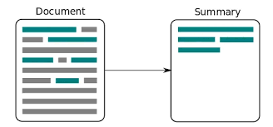
Some documents, like legal papers or technical reports, can be hard to understand. If you’re finding something difficult to read, you can ask the AI to “Summarize this document for me like I’m a 12-year-old.” It will give you a simpler version, so you can understand the main points quickly.
The AI can help by making changes across the whole document, so everything stays uniform and professional.

Slide 8
KEY FEATURES
Content generation and context-aware suggestions: Copilot can generate text based on your instructions.
Formatting assistance: Instead of spending time on manual formatting, ask the AI in Word to apply consistent styles and layouts throughout your entire document.
Data merging: Pull in data from other Microsoft 365 apps, like Excel or PowerPoint, to seamlessly create tables, charts, or other visuals in your Word document.

Slide 9
Enterprise-grade security. :Data security is a top priority for businesses, especially when it comes to AI tools.
Research and reference assistance: If you need to backup your writing with facts or figures, have AI in Word help you find relevant information and add it into your document.
Document summarization:Quickly create summaries of long documents to get the main points without reading through the entire text.

Slide 10

Smart search. Instead of manually looking for specific information in a lengthy document, ask Copilot in Word to locate specific sections, keywords, or data points.
Create images. AI in Word can generate images for documents based on a description of what you’re looking for.

